Slide 1

Chapter 2-1
Database Systems Architecture

Slide 2

Topics
Three levels of architecture
Mappings
Database Administrator (DBA)
Database Management System (DBMS)
Client/Server Architecture

Slide 3
Three Levels of Architecture
External
  Individual user logical
Conceptual
  Community user logical
Internal
  Physical
Three Levels
  See Fig. 2.1
  An Example (Fig. 2.2)
  Detail system architecture (Fig. 2.3)

Slide 4
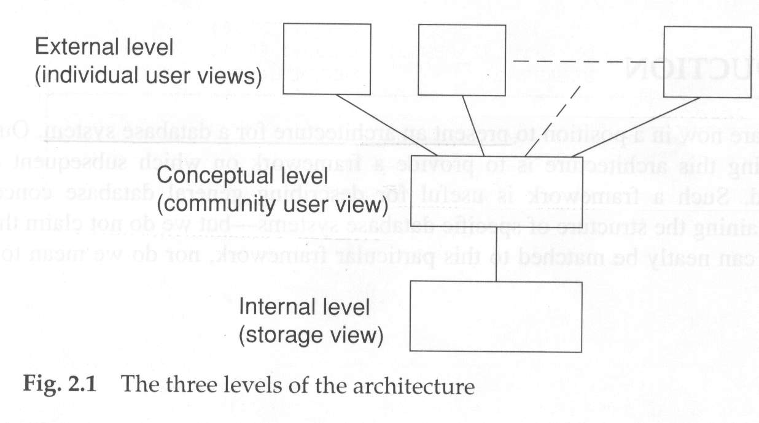

Slide 5
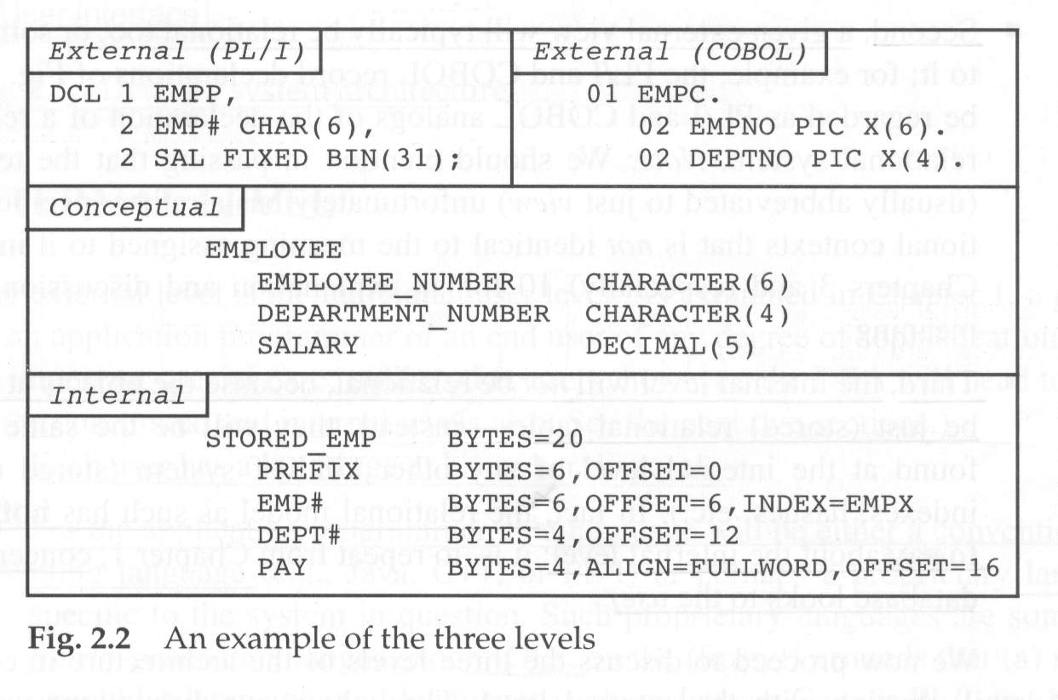

Slide 6
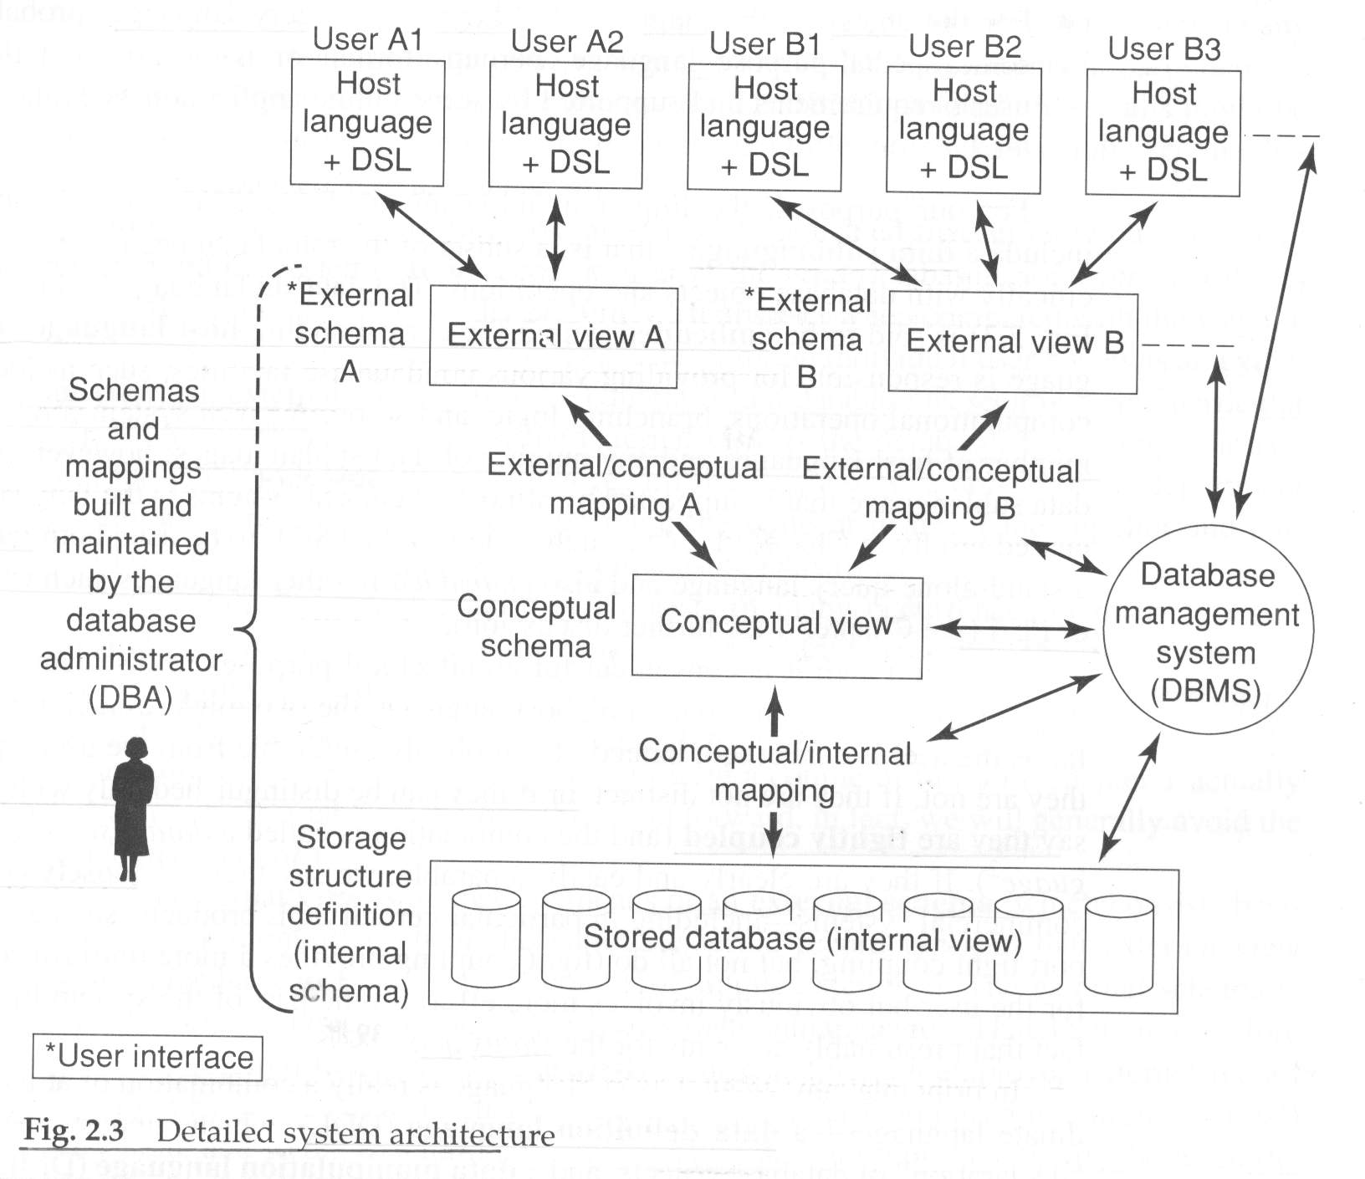

Slide 7
External Level
May support single or groups of users
  Data can be integrated
  Data can be shared
Different users will require different views
Implemented via SQL views
References subsets of information architecture

Slide 8
Conceptual Level
Global logical representation
Shared by all users
A temporal
Underlying meaning of the data
Foundation for database design
Defined by conceptual schema
Implemented via conceptual DDL

Slide 9
Internal Level
Physical layer
  Blocks, pages, I/O
Described by internal schema, DDL
Hardware dependent
Includes structures such as hash, heap, B-tree
Includes pointers

Slide 10
Mappings
Conceptual/internal
  Implementation of logical design
External/conceptual
  Overlapping subsets of views
External/external
  Views mapped to views

Slide 11
Database Administrator
Participates in conceptual database design
Determines how to implement conceptual schema
Teach users, and help them report
Implement security and integrity
Implement unload/reload utilities
Monitor and tune database performance

Slide 12
Database Management System
DDL processor / compiler
DML processor / compiler
Handle scheduled and ad hoc queries
Optimizer and run-time manager
Security and integrity
Recovery and concurrency
Data dictionary
Performance tuning utilities

Slide 13
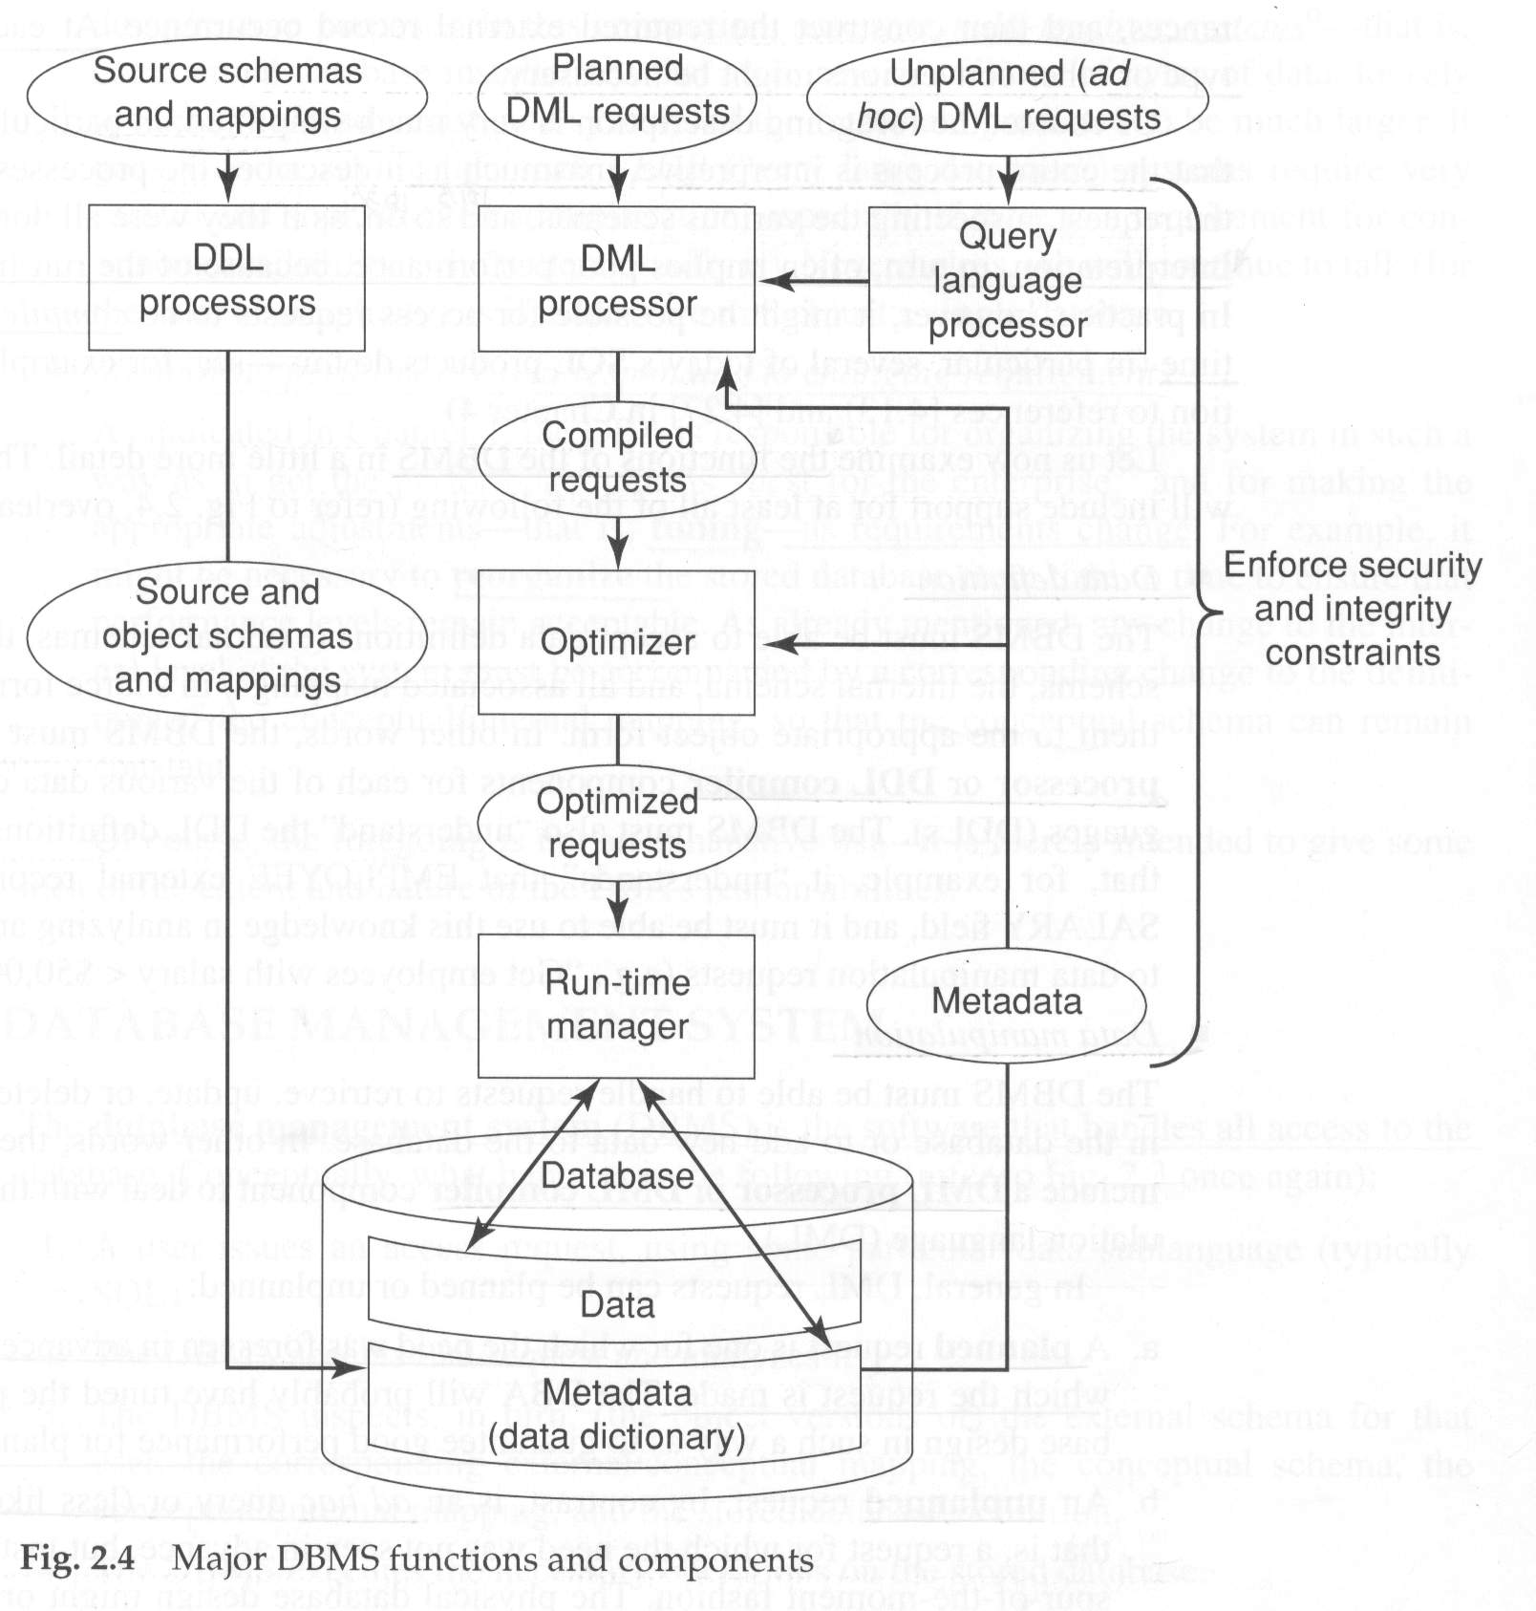

Slide 14
Support for System Processes
Data Communications interface
Client Server Architecture
External tool support: query, reports, graphics, spreadsheets, statistics
Utilities: unload/reload, stats, reorg
Distributed processing

Slide 15
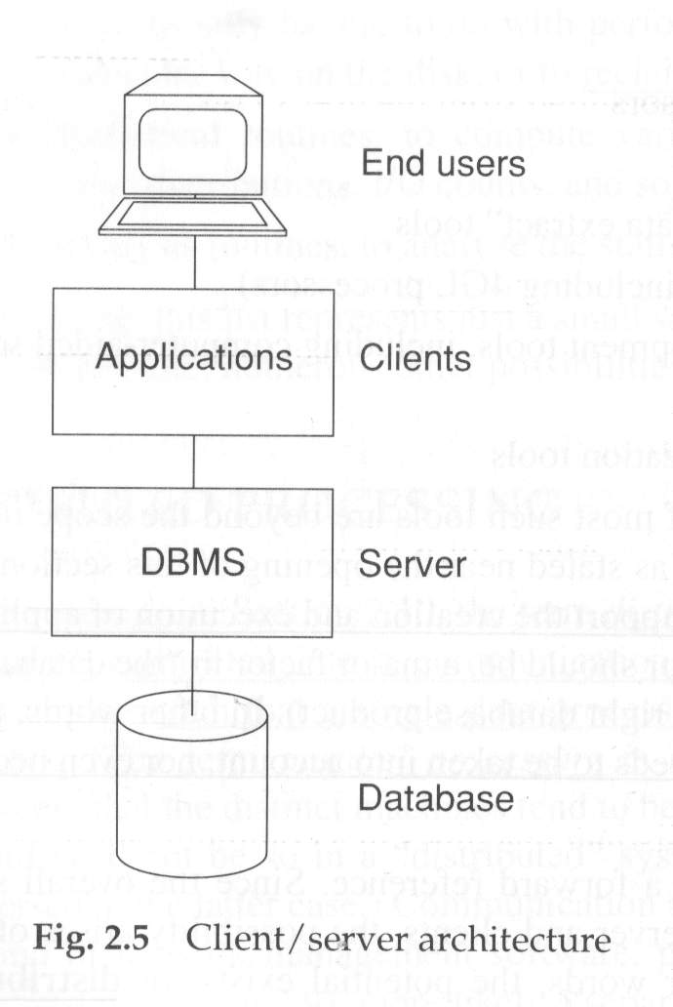
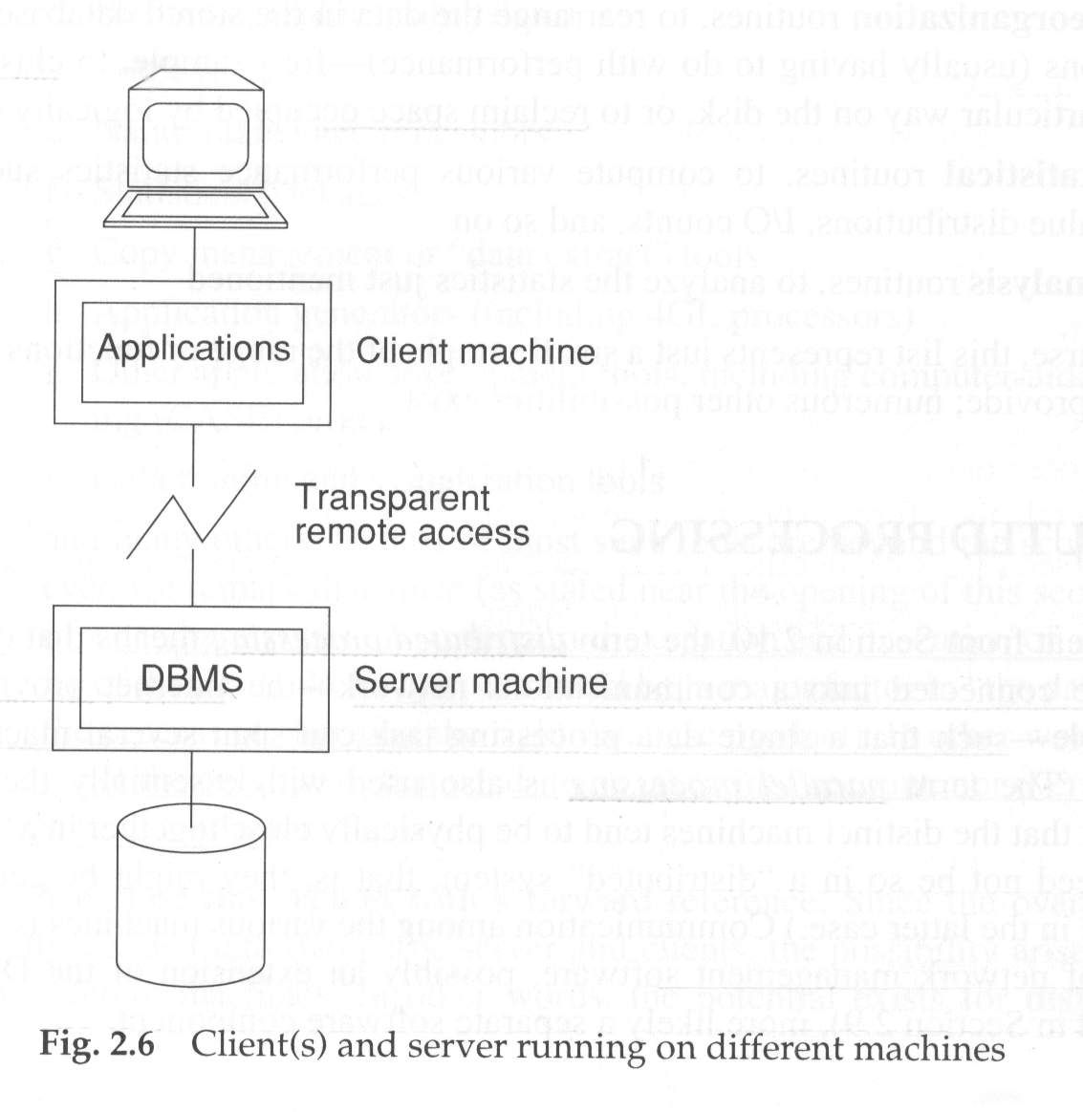

Slide 16
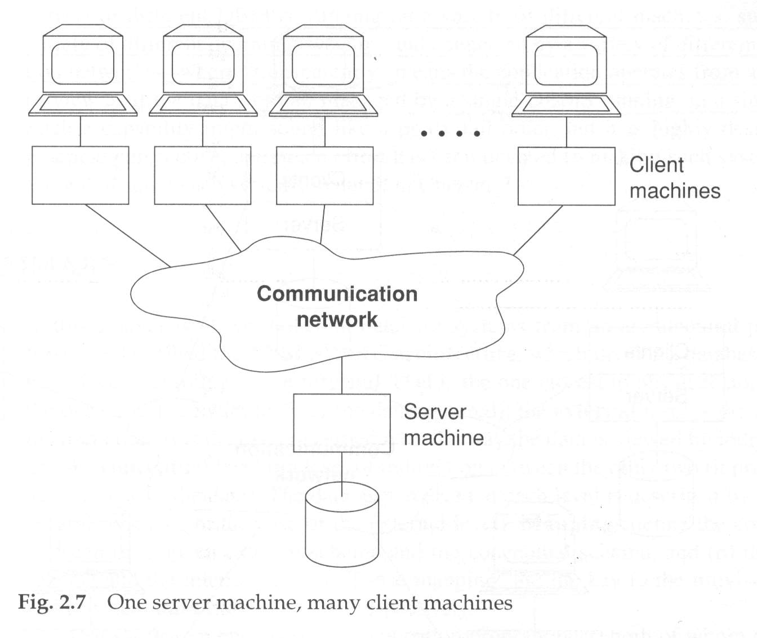

Slide 17
